Slide 1
MongoDb Operators
JITHIN JOSE

Slide 2
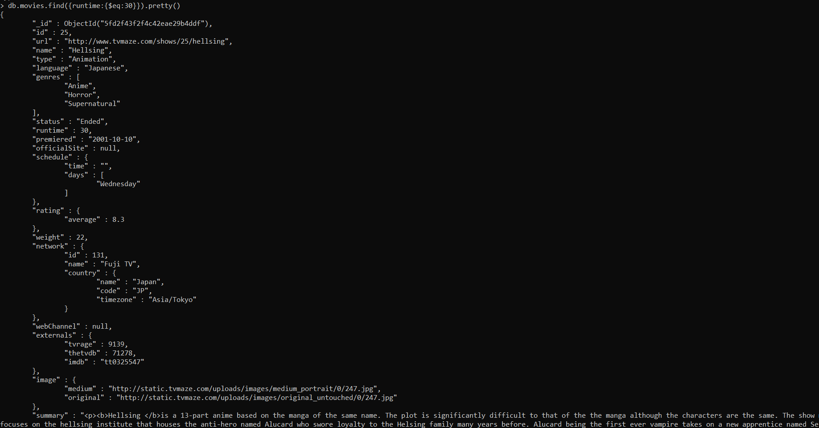
$eq
Matches values that are equal to a specified value.

Slide 3
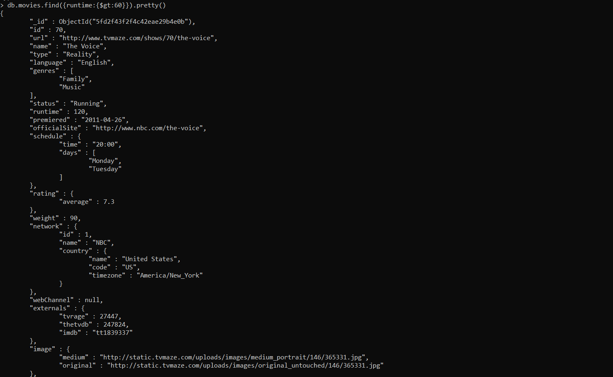
$gt
Matches values that are greater than a specified value.

Slide 4
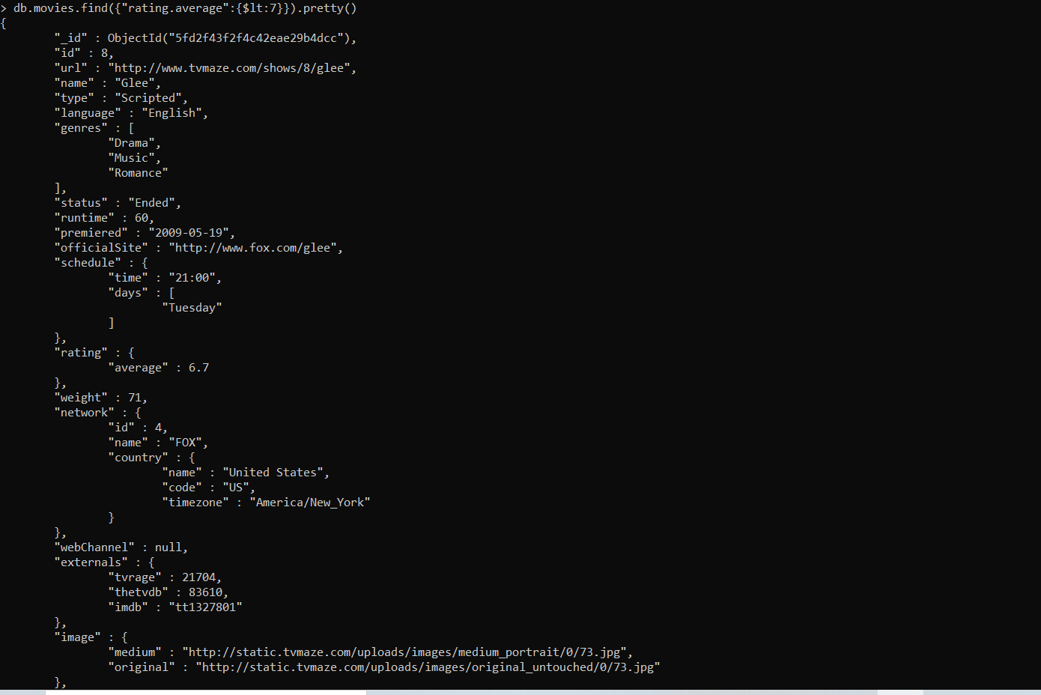
$lt
Matches values that are lesser than a specified value.

Slide 5
$lt
Matches values that are lesser than a specified value.

Slide 6
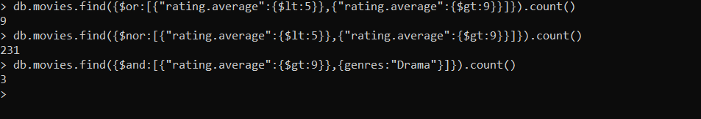
$or, $nor and $and
$or : Joins query clauses with a logical OR returns all documents that match the conditions of either clause.
$nor : Joins query clauses with a logical NOR returns all documents that fail to match both clauses.
$and : Joins query clauses with a logical AND returns all documents that match the conditions of both clauses.

Slide 7
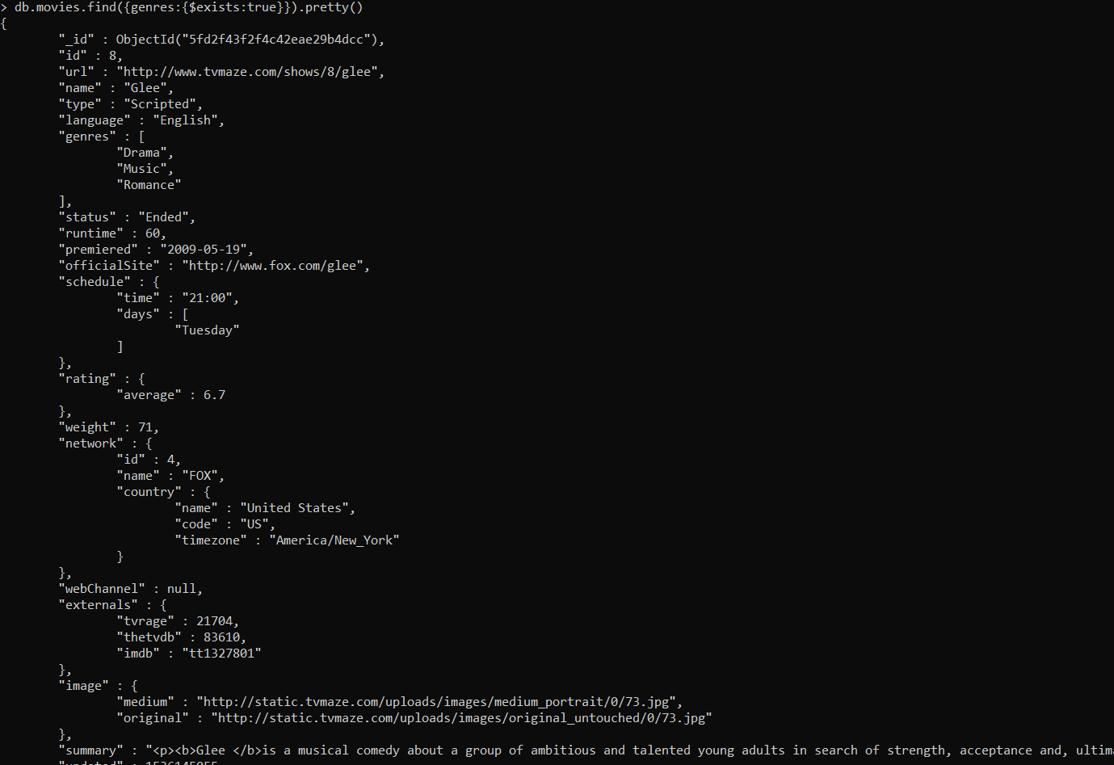
$exists
Matches documents that have the specified field.

Slide 8
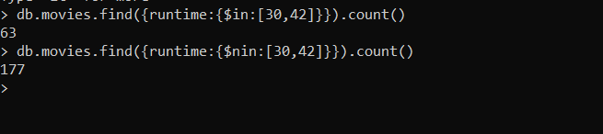
$in and $nin
$in : Matches any of the values specified in an array.
$nin : Matches none of the values specified in an array.

Slide 9
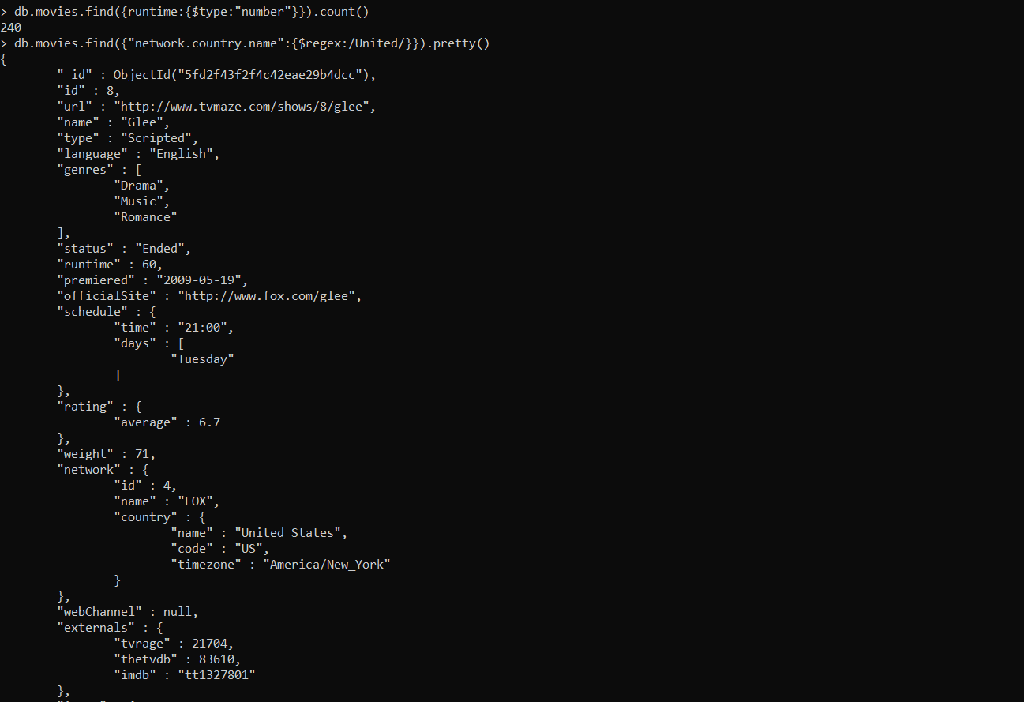
$type and $regex
$type : Selects documents if a field is of the specified type.
$regex : Selects documents where values match a specified regular expression.

Slide 10
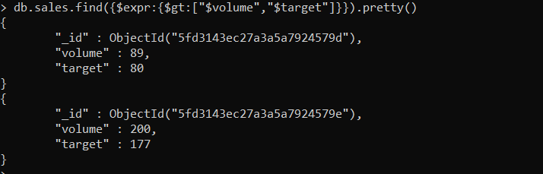
$expr
Allows use of aggregation expressions within the query language.

Slide 11
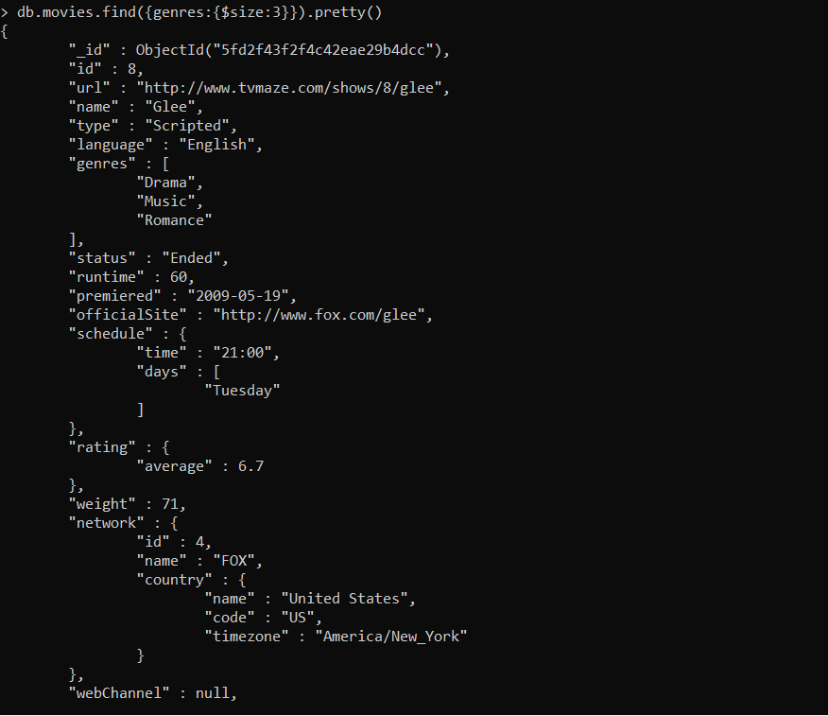
$size
Selects documents if the array field is a specified size.

Slide 12
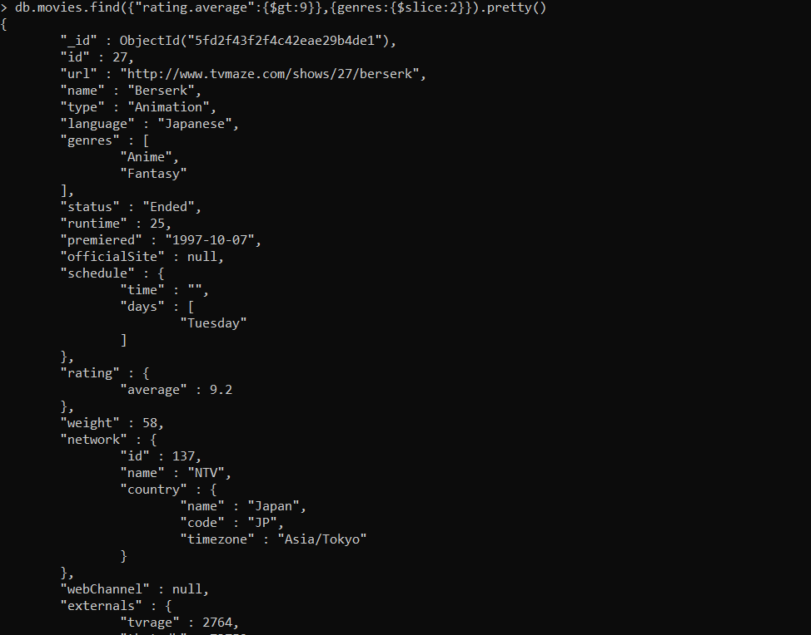
$slice
Limits the number of elements projected from an array. Supports skip and limit slices.

Slide 13
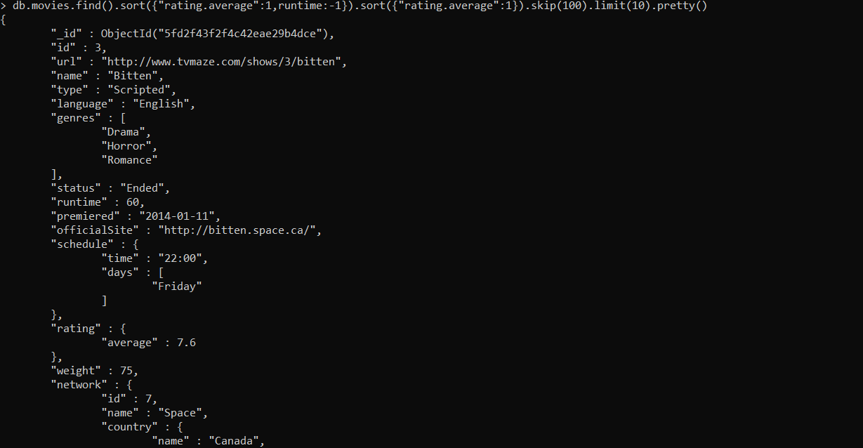
$sort

